Slide 1

Getting the Whole Story: HR Documentation
Provided by the LAUSD Food Services Division
Notes:
PLACEHOLDER

Slide 2
Overview
At the conclusion of this training, managers will be able to:
  Learn ways to motivate employees
  Learn Languages of Appreciation
  Use 4W’s and How
  Effectively complete:
    Positive Reinforcement Log
    Incident Log
    Witness Statement
    Conference Memo
Notes:
Review slide.

Slide 3
Employee Motivation
Notes:
PLACEHOLDER

Slide 4

Motivational Tactics
Discussion
Money/Gifts
Pressure
Yelling
Praise
Recognition
Notes:
Ask participants to share what motivates them. Is it being yelled at, straight talk, gentle encouragement?

Slide 5
Employee Motivation
Do you use similar motivational tactics on your employees?
How do your employees feel about the way you motivate them?
Notes:
Say: Everyone is motivated differently. Do you try to motivate your employees the same way you are motivated? How do your employees react to your tactics?

Slide 6
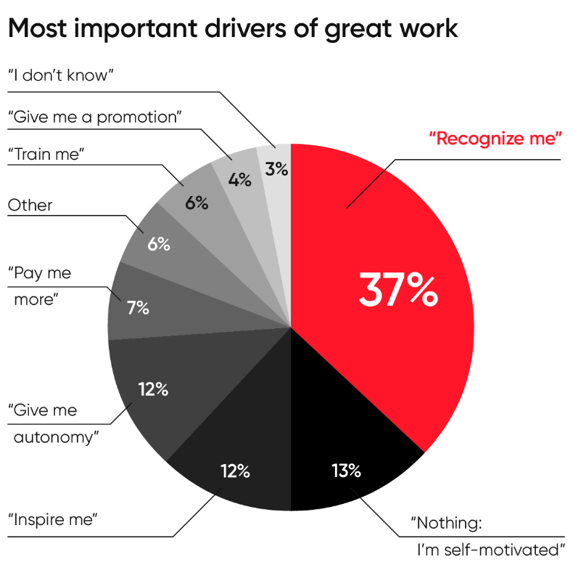
Employee Motivation Study
This study shows that affirmation, feedback and reward are most effective for motivating employees to do their best work.
Notes:
Studies show that recognition is the most effective way to motivate your employees to do their best.

Slide 7

Positive Feedback
Positive feedback is the recognition that focuses on strengths and contributions.
Positive feedback reinforces what people are doing well.
Notes:
Review slide: Emphasize: It is important to catch employee’s doing it right!!! Praise will keep them doing it right again and again.

Slide 8

Positive Reinforcement
Positive reinforcement encourages the desired behavior and is a better motivator than the threat of disciplinary action.
When was the last time you told someone good job?
Notes:
Review slide:

Slide 9

Effects of Positive Feedback
  Positive feedback triggers a reward signal in the brain, reinforcing the action that caused it, and making it more likely to be repeated in the future.
Notes:
Review slide:

Slide 10
Positive Reinforcement Tips
  Ideas to recognize your employees:
  Be specific
  Time and place
  Languages of appreciation
  Little goes a long way
  Connect it to the bigger picture
  Turn a negative into positive
Notes:
Review slide: Be Specific: When recognizing employees, explaining what the recognition is for helps employees relate the recognition to their behavior. Be timely: Recognition that arrives months after the fact isn’t nearly as meaningful as recognition received promptly. The longer it takes for managers to recognize employees, the less likely employees will see the affirmations as authentic. Each employee is different. Get a clearer picture of the primary language of appreciation (in a work setting) of every individual. Then, recognize them accordingly. A little can go a long way: While it's crucial to recognize major accomplishments, don’t overlook the power of the everyday thank-you to motivate employees. These thank-yous and shout-outs don’t have to come from managers alone; some employees may find recognition more motivating when it comes from their peers rather than from leadership. Connect to the bigger picture: Regularly share news about how the company is striving to reach the mission, and explain how individual employee goals relate to that vision.

Slide 11

Language of Appreciation
  There are 4 languages of employee appreciation:
  Words of Affirmation
  Quality Time
  Acts of Service
  Receiving Gifts
Notes:
Say: All employees are not the same. Everyone has a different way that they receive praise and appreciation. You can use these 4 languages to tailor your delivery and show your employee that you appreciate them.

Slide 12
Words of Affirmation
  Nearly half of employees prefer words of affirmation. This can look like:
  Verbal recognition
  Written recognition
  Tailor to employee’s comfort level
Notes:
Get specific.
“Good job” isn’t enough. Appreciation and positive feedback is most effective when it’s sincere and specific. be timely to make your words of affirmation as impactful as possible. Avoid saving up all your praise for an employee’s annual performance review—instead, share appreciation in real-time so the receiver associates your positive words with their specific actions. You can communicate words of affirmation one-to-one or in public spaces or channels, in-person, over Slack, via email, or even with a handwritten note. The most important thing is to tailor your appreciation to the receiver’s personal needs.

Slide 13
Quality Time
  Quality time is about receiving focused attention.
  Mentorship
  Be accessible
  Celebrate success’s
  Take interest in staff’s lives
  Create moments for team bonding
78% of people who work 30-50 hours per week, spend more time with their coworkers than family.
Notes:
For employees who value quality time, having dedicated time to connect with and learn from their coworkers can be hugely impactful. Checking in with your employees on a recurring, consistent basis is a best practice. You also have an opportunity to show appreciation outside of work updates. This can be as simple as asking “how was your weekend” before asking for whatever that thing is that you need.

Slide 14
Acts of Service
  You can show appreciation by performing small acts that support your employees.
  Take one for the team
  Brewing coffee/ Bring snacks
  Take something off their plate

Slide 15
Receiving Gifts
  Sharing gifts that reflect your employees’ interests.
  Can be inexpensive
  Milestone achievements
  Must know your employees

Slide 16
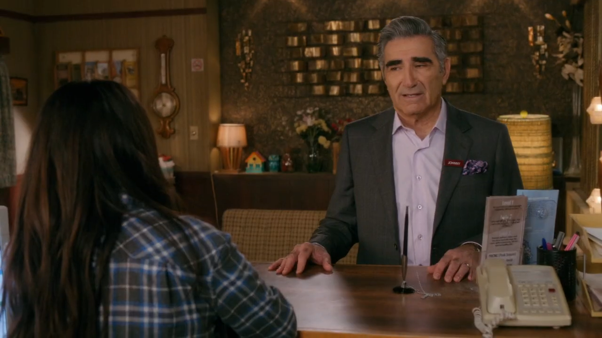
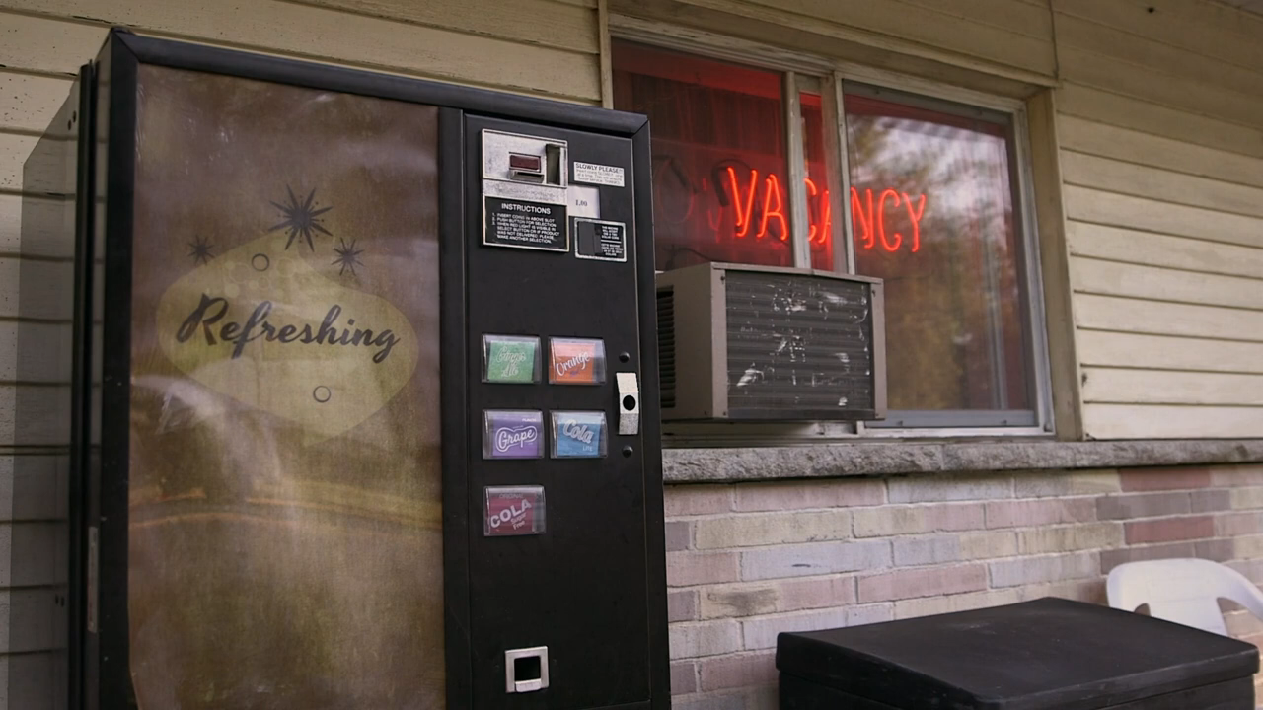
Know Your Employees

Slide 17
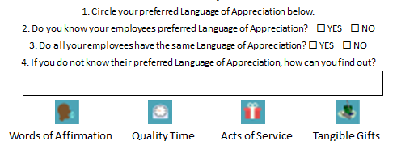
Activity 1
In your workbook, please complete Activity 1:
Notes:
Review slide: These are the benefits of employee recognition

Slide 18

Language of Appreciation Poll
  What is your preferred Language of Appreciation?
  Words of Affirmation
  Quality Time
  Acts of Service
  Tangible Gifts
Notes:
Review slide: These are the benefits of employee recognition

Slide 19

Why It Matters
  Employee recognition helps:
  Retain your staff
  Keep employees engaged
  Encourages better performance
  Higher job satisfaction
Notes:
Review slide: These are the benefits of employee recognition

Slide 20


Catch People Doing Good
Instead of always looking for the things your staff is doing wrong, search for reasons to reward them.
Notes:
Review slide: Emphasize: It is important to catch employee’s doing it right!!! Praise will keep them doing it right again and again.

Slide 21
The 4Ws and How
Notes:
PLACEHOLDER

Slide 22


4W’s and How
The key to successful documentation, positive or negative, is to document the incident with specific details of the event.
Identify the 4 Ws and How:
Notes:
Read slide

Slide 23
Employees
Students
Witnesses
Visitors
Adults: First and last name.
Ex: Courtney Benjamin
Students: First name and initial of last name.
Ex: Dawn S.
Notes:
Who: Provide full name of district employees and other adults involved (parents, coworkers, etc.). Please do not list the last name of students.

Slide 24
Describe the Incident
Words
Actions
Notes:
What: Describe what happened
Objectively (behaviors), not subjectively (attitudes)

Slide 25
Location of Incident
Scramble Area
Walk-In Fridge
Prep Area
Does not encompass all areas an incident can occur.
Notes:
Document the exact location where the incident occurred. Scramble area, walk-in fridge, manager’s office, prep area etc.

Slide 26
Date:
Wed. 8.24.22
Wednesday 8/24/2022
August 24, 2022
Time:
11:33am
10 minutes into lunch service
At dismissal approx. 1:30pm
Be as specific as possible
Notes:
When: Specific date and time, ex. 01/27/21 at 10 am

Slide 27
Impact on Operations
Moral
Service
Staff
Notes:
How: How did behavior impact cafeteria operations?

Slide 28
Prevent Reoccurring Issues
Corrective Actions
Training
Notes:
How: If necessary, what will be done going forward to prevent this incident from reoccurring

Slide 29
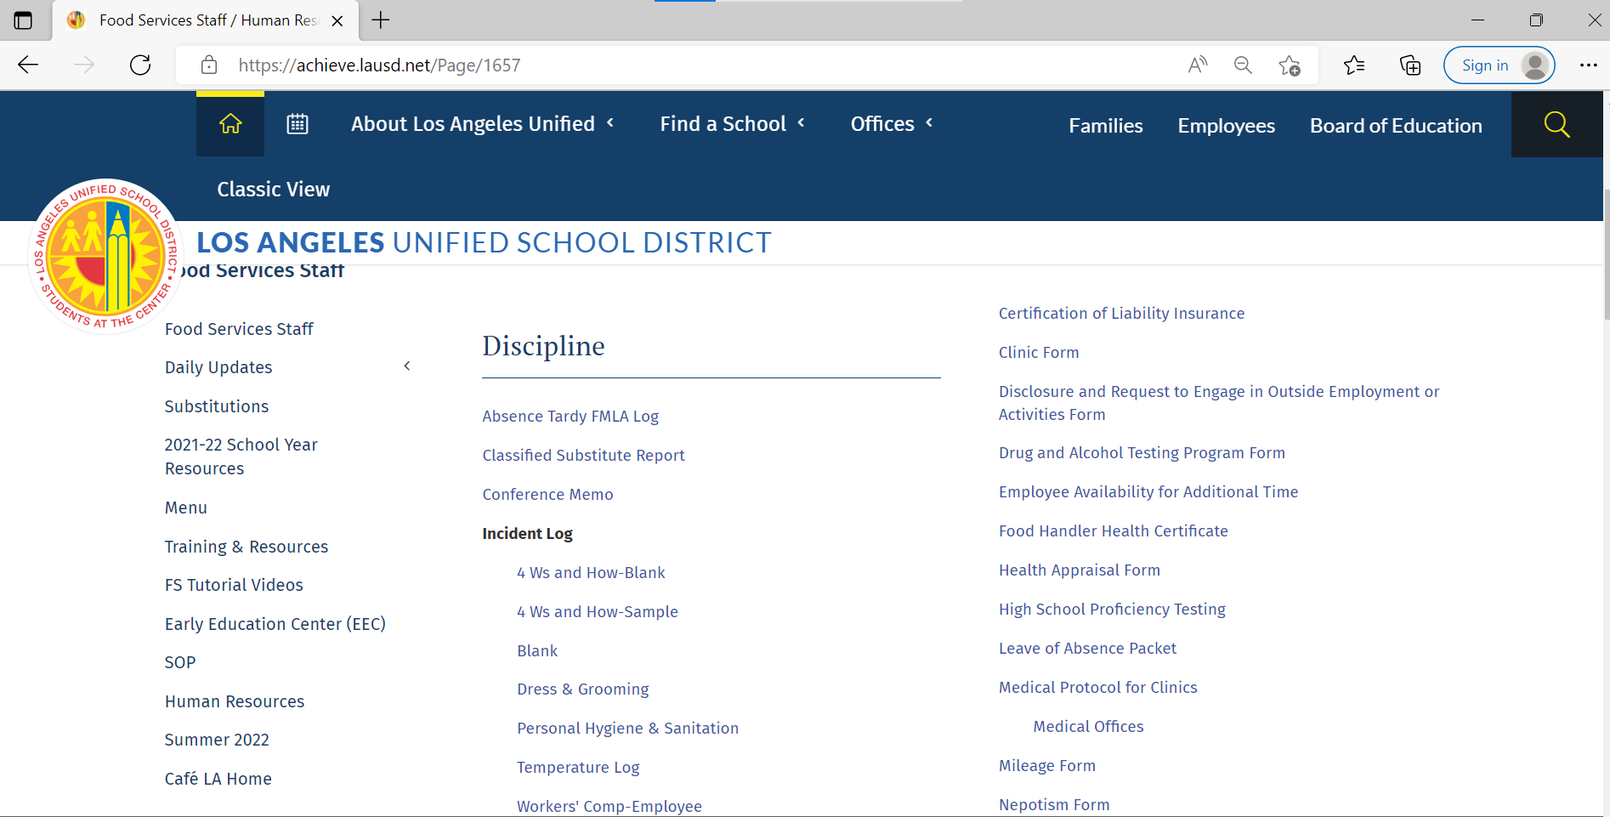
4W’s and How
The 4Ws and How-Blank form is available on
Café LA Website> Human Resources> Discipline> Incident Log
Notes:
Use the 4ws and How blank form to ensure you write a detailed report.

Slide 30
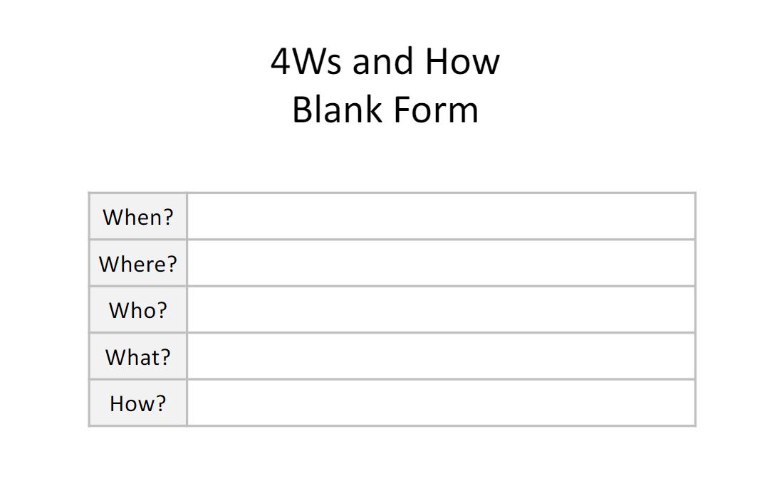
4Ws and How-Blank Form
After using the 4Ws and How-Blank form, please responsibly discard it to protect the confidentiality of involved parties.
The 4Ws and How-Blank form is to be used as a guide when documenting good behavior and incidents in the kitchen.
Notes:
Use the 4ws and How blank form to ensure you write a detailed report.

Slide 31

Acceptable Documentation
Clear and specific documentation is essential to compose any human resources document effectively. Generalizations must be avoided, and misbehavior(s)is clearly identified.
Don’t be afraid to document offensive language, gestures, or behavior. Writing words and actions exactly as they happened is necessary to get an accurate picture of the incident.
Notes:
TELL: Read slide. Generalizations must be avoided, and misbehavior clearly identified.

Slide 32
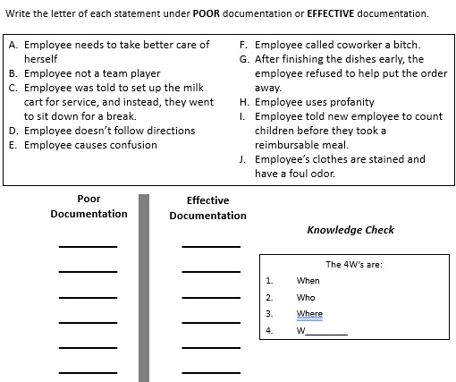
Activity 2
In your workbook on Activity 2 write a letter for each statement under either POOR documentation or EFFECTIVE documentation.
Notes:
Read Slide

Slide 33
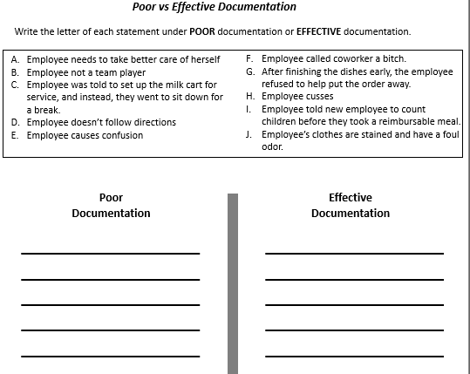

Poor vs Effective Documentation
Notes:
Timer will automatically start

Slide 34
Poor vs Effective Documentation
A
C
B
F
D
G
E
I
H
J
Notes:
Read each example and then click. Answer choices will appear.
Generalizations such as these statements must be avoided at all times when documenting a behavior that needs to be addressed. These generalizations are too vague and do not give any indication of the behavior that the manager is trying to change or improve.

Slide 35
Knowledge Check
Select the correct answer:
The 4 Ws are
  When
  Who
  Where
  W_________
Why
What
Notes:
TELL: The 4 W’s are When, Who, Where, and ________
ANSWER: What.

Slide 36
Token of Appreciation
Notes:
PLACEHOLDER

Slide 37
Token of Appreciation
When you catch your employee going above and beyond their duties to help cafeteria operations, give them a token of appreciation.
Use any of the 4 Languages of Appreciation to applaud the efforts of your employees.

Slide 38
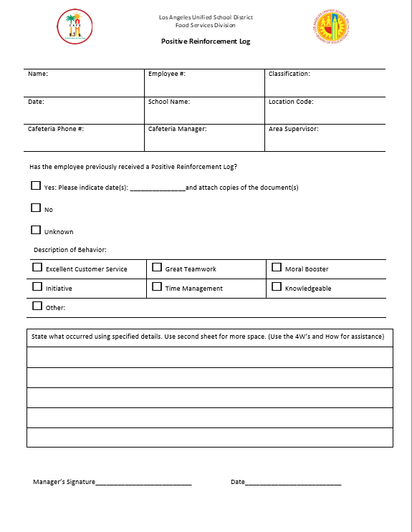
Token of Appreciation
The Positive Reinforcement Log
documents an employee's excellent behavior.
To enhance the Language of Appreciation, provide a
Positive Reinforcement Log.
Note: Print out copies of the Positive Reinforcement Log so that you are always prepared to recognize your employees.
Notes:
Congratul

Slide 39

Breakout Room
Use the following example to create a Positive Incident Log.
Use the 4Ws and How to create a detailed report.

Slide 40
Activity 3
On Tuesday June 14th, the cafeteria manger at ABC Academy went to an offsite Manager’s meeting.
A parent called asking for information about the menu, concerned their child may possibly be allergic to an ingredients.
Maria Carter answered the phone and was able to assist the parent with the ingredients on the menu for the day. She also directed the parent to the Food Services website to see the current menu.

Slide 41

Breakout Room
5 Minutes

Slide 42
Maria Carter
12345678
FSW
June 14, 2022
ABC Academy
1234
555-123-4567
Your name
Your Supervisor

Slide 43
On June 14th, while I was away at my manager’s meeting, Maria Carter gave excellent customer service over the phone to a parent. She not only performed her job duties, but she went above and beyond to ensure the parent was satisfied. Maria displayed great knowledge of our products. She took the initiative to give the parent access to the menu so that they could stay informed on our offerings. Maria’s act boosted my confidence in her abilities as a worker.
Place your Signature
6/14/2022

Slide 44
Incident Logs
Notes:
PLACEHOLDER

Slide 45
Set Up for Success
Ensure that your staff is equipped with the tools and resources to do their job successfully.
  Managers train employees on policies, procedures, recipes etc. on a regular basis
  Provide frequent feedback and coaching
  Encourage employees to take professional development classes offered by
    Organizational Excellence (OE),
    Food Services Division (EPIC courses)
    MyPLN
      Multiple Course available on MyPLN
Notes:
We often do not bring up our handbook until a disciplinary issue arrives. Don’t set your team up for failure. Set them up for success by equipping them with the knowledge and tools they need to accurately do their job.

Slide 46
Set Expectations
Always set expectations right from the start.
  Review the Food Services Division’s Employee Handbook with every employee
  Review Orientation Checklist with newly hired, promoted, transferred employee
    Café LA Website
    Human Resources
    Employee Handbook
  Review annual manager orientation materials
Notes:
TELL: Clearly set expectations right from the start! Review the Food Services Division’s Employee Handbook with every employee. This should be done at the start of every school year. Review orientation checklist with newly hired, promoted, transferred employee. Remember, even if an employee has been with the district for 20 years and is transferred to your location, you must still review the Employee Handbook with all regular employees who are at your school and refresh annually!

Slide 47
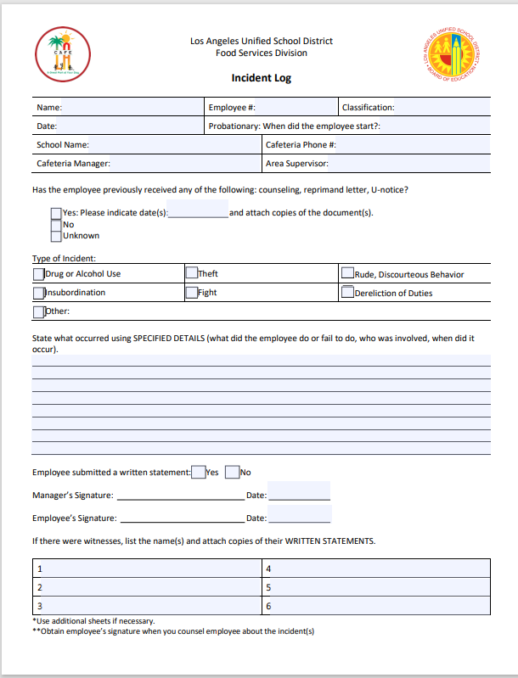
Discipline Documents
  An Incident Log is a spot training tool used to inform the employee of the correct way to perform the job.
Notes:
Review slide. Say ”Consult your AFSS/HR”. Explain that nothing on this list is actual discipline and is only correction. We are not required to go in the order listed. Use example of an employee argument that leads to them getting in each others faces. Ask class which type of correction they would use?

Slide 48
What is an Incident Log?
Incident Logs are used to:
  Document operational issues in your cafeteria
  Document concerns about performance
  Record informal or verbal counseling
With no evidence of counseling, it will be difficult to impose discipline in the future.
Notes:
TELL: Now let’s move on and discuss incident logs. An incident log is not a disciplinary document, but a training tool used to identify errors in the employee’s performance or behavior and provide coaching and counseling for corrective action. Incident logs are used to document problems in your cafeteria and concerns about performance It is a record of counseling for both informal and verbal counseling.
Please Note: With no evidence of counseling, it will be difficult to impose discipline in the future.

Slide 49
Discipline
An Incident Log is not discipline.
Discipline is any action that effects your paycheck such as suspension or demotion.

Slide 50
  Incident Log Issues
Document the following behaviors in the cafeteria by using an Incident Log:
Dereliction of Duty/Inattention to Duty
  Insubordination
  Drug or Alcohol Use
  Theft
  Fighting (Verbal altercation)
  Rude, Discourteous Behavior
Notes:
TELL: Incident Logs are issued when the following types of incidents occur in the cafeteria: Dereliction of Duty-Failure to follow directions, rules or procedures. An example could be an employee failing to take the temperature of the chicken before lunch service. Failure to complete an assignment-could be when an employee fails to put away grocery/staples as assigned on her work schedule. Abandoning your post- Leaving your designated post to do something you were not directed to do or just to be missing from your post without good reason.

Slide 51
Incident Log Authority
An Incident Log can be issued by an employee in a supervisory position such as:
  Food Services Manager
  Area Food Services Supervisor
  Human Resources Personnel
Notes:
TELL: An Incident Log can be issued by an employee in a supervisory position such as: Food Services Manager, Senior Food Services Worker, Area Food Services Supervisor, and Human Resources Personnel. Note: This document is confidential and not to be shared with other employees in the cafeteria.

Slide 52
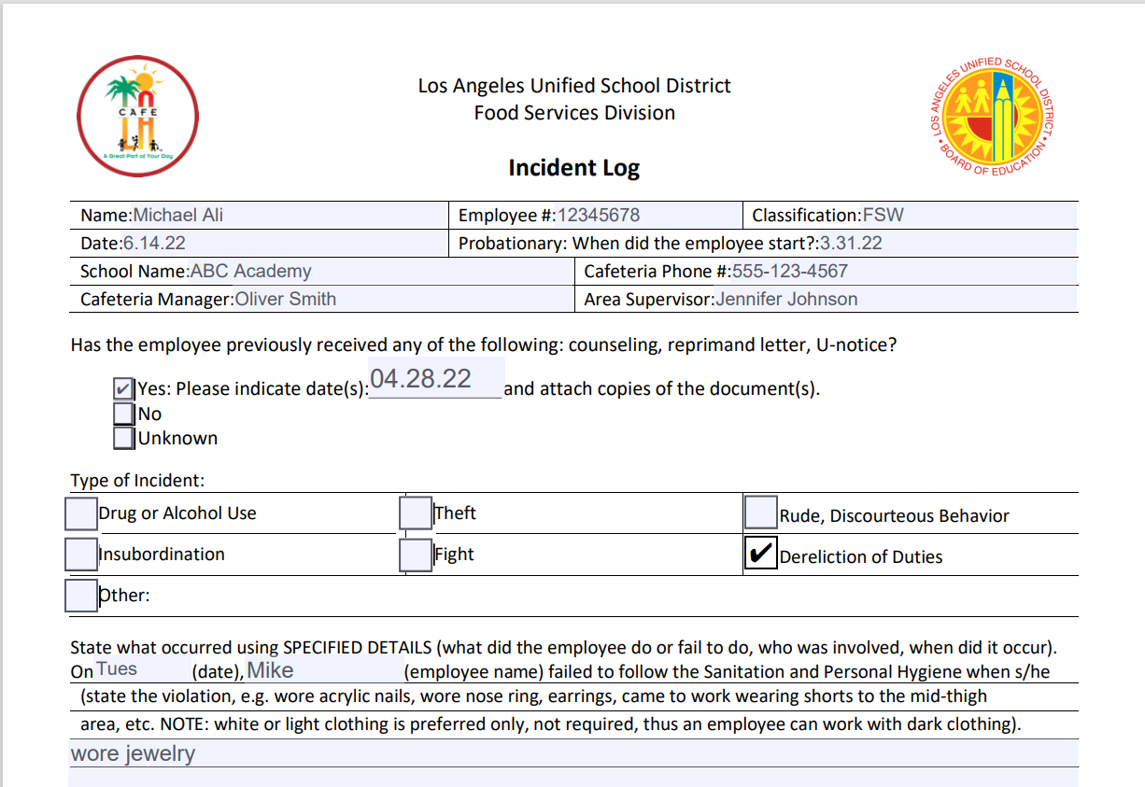

Activity 4: What’s Missing?
Read the provided Incident Log in your workbook. When thinking about the 4Ws and How, can you point out what’s missing?

Slide 53
Activity 4: What’s Missing?
Notes:
Click for each answer. Date, name and description are all vague.

Slide 54


Effective Training
If you must administer an Incident Log within the week for the same offense, you need to evaluate whether your training was effective.

Slide 55
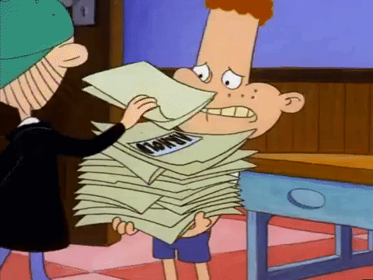
Harassment
There is a point when excessive documentation becomes harassment.
Notes:
Giving an employee incident log after incident log in a short time frame is harassment.

Slide 56
Effective Training
Remember, Incident Logs are training documents.
Every Incident Log needs to come with evidence of training.

Slide 57
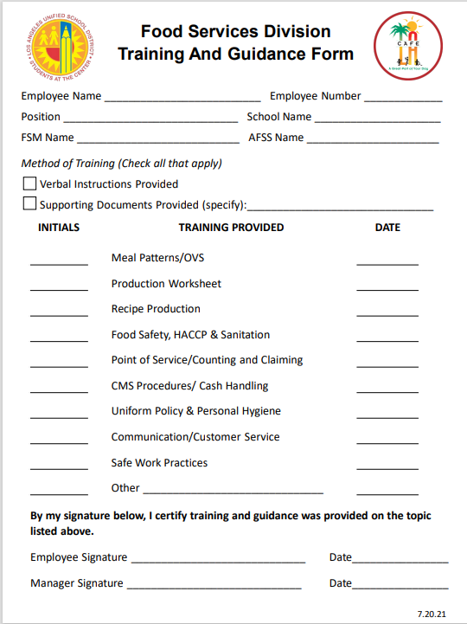
Training and Guidance Form
Use the Training and Guidance form as a tool to further document which training has been provided to an employee.

Slide 58
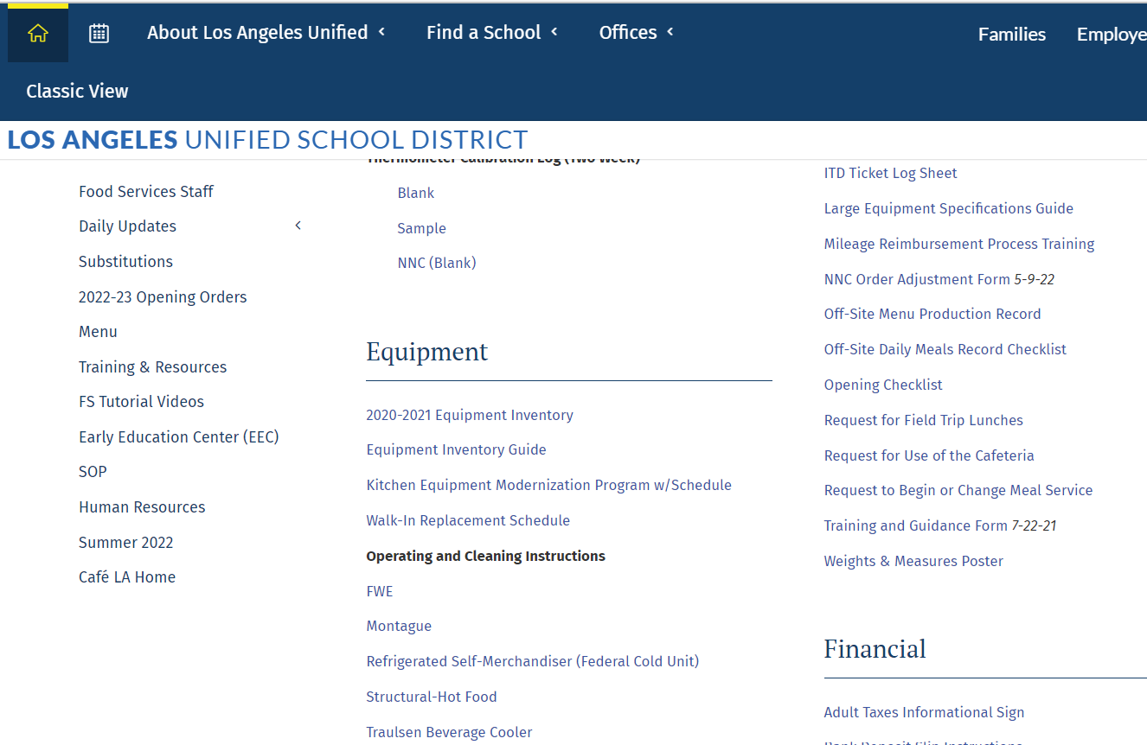
Training and Guidance Form
To find the Training and Guidance form:
Café LA > Training and Resources >
Food Services Resources

Slide 59
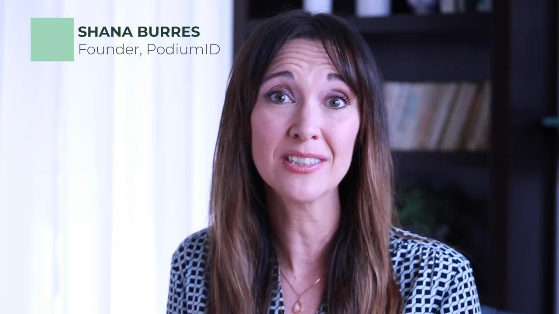
Notes:
Video will automatically play

Slide 60
Breakout Room
Use the following example to create an Incident Log and Witness Statement. Remember to use the 4Ws and How to create a detailed report.

Slide 61
Activity 5
On October 15,2021 you are sitting in your office when you hear a commotion in the area where the workers are preparing BIC bags.
You go to the POS area and notice Janet Dough, Celia Marks and Ashley Lincoln standing around tensely. None of the workers are speaking.
Notes:
Read the slide. Click after each box.

Slide 62
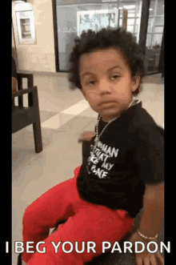
Activity 5
You ask them what happened, and Celia says, "Janet called me stupid.”
Janet replied, “Celia needs to work more independently. She’s constantly asking me the same thing repeatedly.”
Notes:
Read the slide. Click after each box.

Slide 63
Activity 5
You call Ashley into your office, and she tells you, “I heard Janet call Celia stupid after Celia asked Janet if she counted the apples. This was Celia’s 2nd time asking Janet if she counted the apples.”
You decide to write Janet an Incident Log. When you present the Incident Log to her, she refuses to sign.
Notes:
TELL: Let’s read the following scenario.

Slide 64
Breakout Room
5 Minutes

Slide 65
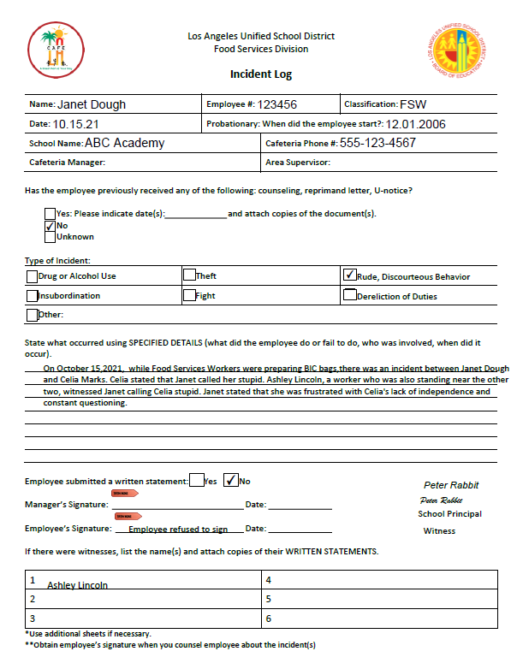
Activity 5: Incident Log
Notes:
Tell: Example 2 is an incident pertaining to rude, discourteous behavior. Notice how the manager marked the appropriate box on the ‘Type of Incident” section. This is Janet’s first incident.

Slide 66
Notes:
TELL: This is the bottom section of the Incident Log. The manager wrote “employee refused to sign” on the employee signature and asked Principal Peter Rabbit to sign the Incident Log as a witness. In addition, the manager wrote the name of Ashley Lincoln, as a witness to the incident that happened on 10/15/21.
Remember: If an employee refuses to sign, you will need a witness that an Incident Log was issued and handed over to the employee.

Slide 67
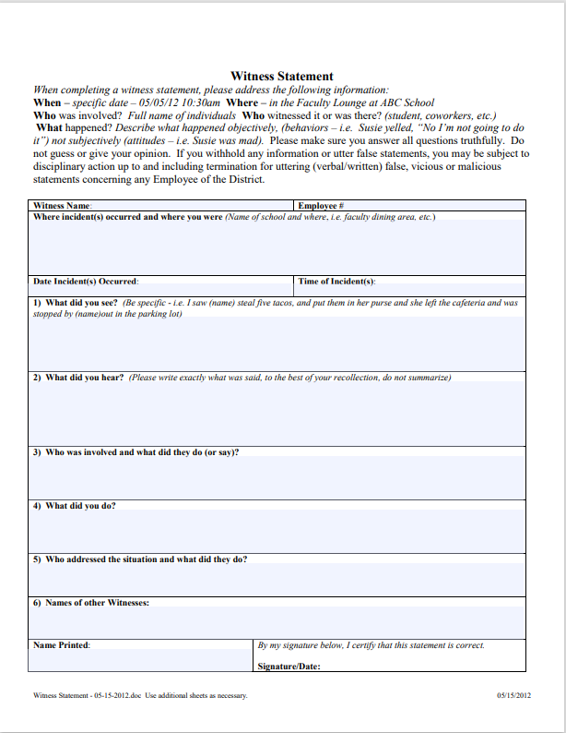
Activity 5: Witness Statement
Witness Statement Instructions
Ashley Lincoln
12345678
The incident took place near the POS area at ABC Academy. I was standing near Janet and Celia.
10/15/21
During morning prep of BIC bags
I saw Janet and Celia get into a confrontation while packing the BIC bags.
I heard Janet call Celia stupid after Celia asked Janet if she counted the apples again.
Notes:
Tell:

Slide 68
Janet Dough – Called Celia stupid
Celia Marks – Asked Janet if she counted the apples more than once.
I was not involved and did not intervene.
The manager called all of us into their office, one by one.
N/A
Ashley Lincoln
Ashley Lincoln/ oct 15, 21
Make sure to be as specific as possible
Notes:
TELL: This is the bottom section of the Incident Log. The manager wrote “employee refused to sign” on the employee signature and asked Principal Peter Rabbit to sign the Incident Log as a witness. In addition, the manager wrote the name of Ashley Lincoln, as a witness to the incident that happened on 10/15/21.
Remember: If an employee refuses to sign, you will need a witness that an Incident Log was issued and handed over to the employee.

Slide 69
Escalation
In certain instances, it may be necessary to use a Conference Memo instead of an Incident Log. These instances are:
After training continues and employee is still unable to meet minimum work performance
The infraction was flagrant in nature

Slide 70
  Conference Memo Issues
  Conference Memos are issued for more serious offenses such as:
  Discourteous, abusive or threatening treatment of employees/students
    Using profanity, yelling or arguing
    Touching a student to stop him/her from taking extra food or being disruptive
  Unauthorized use of District or student body or property (i.e. telephones, computers, sale of food/supplies)
Notes:
TELL: Other types of incidents is discourteous, abusive or threatening treatment of employees and students –Such as: Using profanity, yelling or arguing. We understand that sometimes people disagree. But Food Svc intends to promote a culture of respectful communication and/or treatment. Touching students except when accidental should not happen. We all sign the Code of Conduct with Students, which says that your contact with students should be appropriate and job duty specific at all times. Frequent unexcused absence/tardy –An example is: an employee taking the Fridays and Mondays off during a long holiday weekend without an approved vacation or leave. Another example is an employee who is a “No Show/No Call” and stops reporting for work in the next three days.

Slide 71
  Conference Memo Issues
  Conference Memos are issued for more serious offenses such as:
  Frequent unexcused absence or tardiness
    Multiple No Show/No calls or consistent pattern of unexcused absences or tardiness
  Harassment/Abusive comments to others
  Leaving work site w/out authorization
  Making false misleading statements
This list is not inclusive of all reasons to issue a Conference Memo.
Notes:
TELL: Other types of incidents is discourteous, abusive or threatening treatment of employees and students –Such as: Using profanity, yelling or arguing. We understand that sometimes people disagree. But Food Svc intends to promote a culture of respectful communication and/or treatment. Touching students except when accidental should not happen. We all sign the Code of Conduct with Students, which says that your contact with students should be appropriate and job duty specific at all times. Frequent unexcused absence/tardy –An example is: an employee taking the Fridays and Mondays off during a long holiday weekend without an approved vacation or leave. Another example is an employee who is a “No Show/No Call” and stops reporting for work in the next three days.

Slide 72
Incident Log vs Conference Memo
  An Incident Log is a spot training tool used to inform the employee of the correct way to perform the job.
A Conference Memo identifies that the employee knows or should know a process, offers assistance and/or further training, and states consequences if not followed.
Notes:
Review slide. Say ”Consult your AFSS/HR”. Explain that nothing on this list is actual discipline and is only correction. We are not required to go in the order listed. Use example of an employee argument that leads to them getting in each others faces. Ask class which type of correction they would use?

Slide 73
Knowledge Check
What is the training tool used to inform the employee of the correct way to perform the job?
Select the correct answer:
Incident Log
Conference Memo
Notes:
TELL: Time for a paddle activity. What is the training tool used to inform the employee of the correct way to perform the job?
Please raise your paddle according to your selection.

Slide 74
Contact AFSS/HR
Before writing and issuing a Conference Memo, consult with your AFSS or HR Rep for assistance in drafting the document.

Slide 75
Breakout Room
Use the following example to match statements to the sections they belong to on Conference Memo.

Slide 76
Activity 7
On Jan 27, 2022 @ 9:30 am, staff were taking their break in the faculty lounge. During the break, Veronica Smith approached Marian Garcia and yelled, “I know you’re talking about me! Say it in English bitch! ”
Note: When composing the Incident log, keep the 4Ws and How in mind.
Notes:
TELL: Let’s read the following scenario. On January 27, 2021 @ 9:30 am the staff were taking their break in the faculty lounge. During the break, Melissa Smith came within two inches of Sonia Hernandez’s face, and pointed her finger towards Sonia’s eye and yelled, “I’m tired of your silly ass”. Note: When composing the Incident log for this situation, keep the 4 “W”s and How in mind.

Slide 77
Breakout Room
5 Minutes

Slide 78
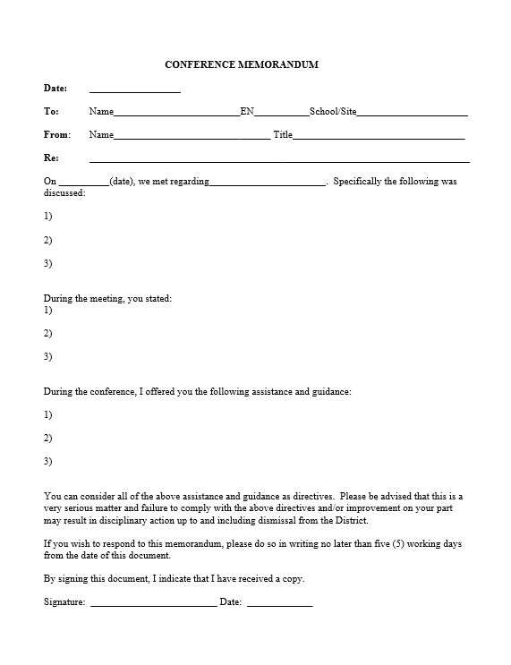
When? | On 01/27/22, during the 9:30 am break
Where? | In the faculty lounge
Who? | Veronica Smith and Marian Garcia
What? | Veronica Smith came within two inches of Marian Garcia’s face, pointed her finger towards Marian’s eye and yelled, “I’m tired of your dumb ass”.
How? | Staff morale and teamwork decreased.
Conference Memo Review
Jan 27, 2022
Veronica Smith
3567234
ABC Academy
Jane Doe
FSM
01.27.22
Discourteous, abusive or threatening treatment of Employees/Students
Your statement of “speak English Bitch.” when addressing Marian was abusive.
You violated of the district’s policy regarding discrimination based on language spoken. You were overheard making harassing comments about Marian speaking another language.
Notes:
TELL: Let’s compare a poor versus an effective example. A poor example is: Melissa got mad and yelled at Sonia. An effective example is going through the 4 “W”s and How. When did it happen? On 01/27/21 during break. Where did it occur? In the faculty lounge. Who was involved? Melissa Smith and Sonia Hernandez. What happened? Melissa Smith came within two inches of Sonia Hernandez’s face, pointed her finger towards Sonia’s eye and yelled, “I’m tired of your silly ass.” How did this impact the cafeteria? Staff morale and team work decreased.

Slide 79
Conference Memo Review
Marian is always speaking in another language which I find rude. I know she can speak English, but she says things in another language so that I don’t know what she’s saying.
EAP Referral and conduct retraining on our FSD Employee Handbook policy regarding the Board of Education Resolution to Enforce the Respectful Treatment of All Persons.
Notes:
TELL: Let’s compare a poor versus an effective example. A poor example is: Melissa got mad and yelled at Sonia. An effective example is going through the 4 “W”s and How. When did it happen? On 01/27/21 during break. Where did it occur? In the faculty lounge. Who was involved? Melissa Smith and Sonia Hernandez. What happened? Melissa Smith came within two inches of Sonia Hernandez’s face, pointed her finger towards Sonia’s eye and yelled, “I’m tired of your silly ass.” How did this impact the cafeteria? Staff morale and team work decreased.

Slide 80
Conference Memo Review
Veronica Smith
01/27/22
Have employee sign the Conference Memo.
If the employee refuses, have a witness verify they saw the employee receive the Conference Memo by signing the document.
Notes:
TELL: Let’s compare a poor versus an effective example. A poor example is: Melissa got mad and yelled at Sonia. An effective example is going through the 4 “W”s and How. When did it happen? On 01/27/21 during break. Where did it occur? In the faculty lounge. Who was involved? Melissa Smith and Sonia Hernandez. What happened? Melissa Smith came within two inches of Sonia Hernandez’s face, pointed her finger towards Sonia’s eye and yelled, “I’m tired of your silly ass.” How did this impact the cafeteria? Staff morale and team work decreased.

Slide 81

Supporting Documentation
Writing an Incident Log or Conference Memo is not complete until you add supporting documentation.
Notes:
TELL: Aside from the Absence/Tardy/FMLA log, the manager must also attach a copy of the Attendance Policies found in the Employee Handbook and indicate where the employee failed to follow. Note, employee’s initials are on the left hand side of the as proof that training was provided.

Slide 82
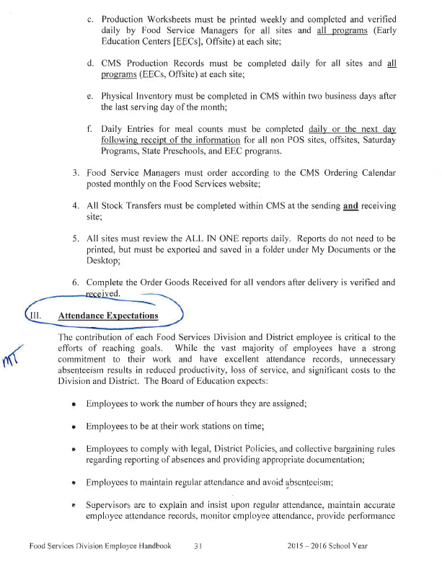
Supporting Documentation
Supporting documentation should include a copy of the policy that was violated, along with the employees initials next to the policy.
Notes:
TELL: Aside from the Absence/Tardy/FMLA log, the manager must also attach a copy of the Attendance Policies found in the Employee Handbook and indicate where the employee failed to follow. Note, employee’s initials are on the left hand side of the as proof that training was provided.

Slide 83

Reminders
Key points to remember when providing effect documentation:
These documents and situations are confidential and not to be shared with other employees in the cafeteria.
Progressive discipline is an essential practice to address issues in your Café LA operations. Utilize the tools and resources provided to guide you through the process effectively.
As always, contact your supervisor for assistance and guidance. The Division’s Human Resources Team is available to assist both FS Managers and AFSS on the implementation of progressive discipline.
Notes:
TELL: Progressive discipline is an essential practice to address issues in your Café LA operations. Utilize the tools and resources provided to guide you through the process effectively.
As always, contact your supervisor for assistance and guidance. The Division’s Human Resources Team is available to assist both FS Managers and AFSS on the implementation of progressive discipline.

Slide 84
References
To find more information regarding training materials, visit your Food Services Division website:
http://achieve.lausd.net/Page/1657
Notes:
TELL: Visit the Human Resources section of the Food Services Division Website frequently and navigate through the different Incident Log sample forms. The FSD website contains various resources such as power-point training topics and forms that answers most of your day-to-day Human Resources-related inquiries.

Slide 85
Thank You!
LAUSD Food Services Division
Nourishing Children to Achieve Excellence
Notes:
TELL: Questions? Thank you.

